Slide 1

Azure Synapse Analytics Technical Boot Camp Day 3
Notes:
Welcome to the first day of the Azure Synapse Analytics technical boot camp.
This training provides practical guidance on the design, implementation, and operation of an Azure Synapse Analytics solution.
Let’s take a moment now and introduce the team ….. {introduce yourself and your colleagues}
Okay let’s get started!

Slide 2
A look into Day 3
Model | 8:00-8:05 | Welcome | Main Call
 | 8:05-9:00 | Synapse Spark
 | 9:00-10:00 | Build Hands-on: Machine Learning | Table Group Call
 | 10:00-10:15 | Break
 | 10:15-11:00 | Build Hands-on: Spark
 | 11:00-11:45 | Activity: CI/CD with Synapse Workspaces | Main Call
 | 11:45-12:45 | Break | Main Call
Monitor | 12:45-13:25 | Monitor & Manage | Main Call
 | 13:25-13:45 | Activity: Monitor & Manage
 | 13:45-14:00 | Break
 | 14:00-14:45 | Build Hands-on: Monitoring | Table Group Call
 | 14:45-15:00 | Closing and Q&A | Main Call
Today we will be learning and collaborating across three spaces:
Main call (this meeting)
Table Group channel within the event Team
CloudLabs Learner Portal & Synapse environment
Presentation/
Whole Group
Lab
Activity/ Discussion/ Group Work
Announcements

Slide 3
A look into Day 3
Model | 6:30-6:35 | Welcome | Main Call
 | 6:35-7:30 | Synapse Spark
 | 7:30-8:30 | Build Hands-on: Machine Learning | Table Group Call
 | 8:30-8:45 | Break
 | 8:45-9:30 | Build Hands-on: Spark
 | 9:30-10:15 | Activity: CI/CD with Synapse Workspaces | Main Call
 | 10:15-11:15 | Break | Main Call
Monitor | 11:15-11:55 | Monitor & Manage | Main Call
 | 11:55-12:15 | Activity: Monitor & Manage
 | 12:15-12:30 | Break
 | 12:30-1:15 | Build Hands-on: Monitoring | Table Group Call
 | 1:15-1:30 | Closing and Q&A | Main Call
Today we will be learning and collaborating across three spaces:
Main call (this meeting)
Table Group channel within the event Team
CloudLabs Learner Portal & Synapse environment
Presentation/
Whole Group
Lab
Activity/ Discussion/ Group Work
Announcements

Slide 4
Synapse Spark

Slide 5
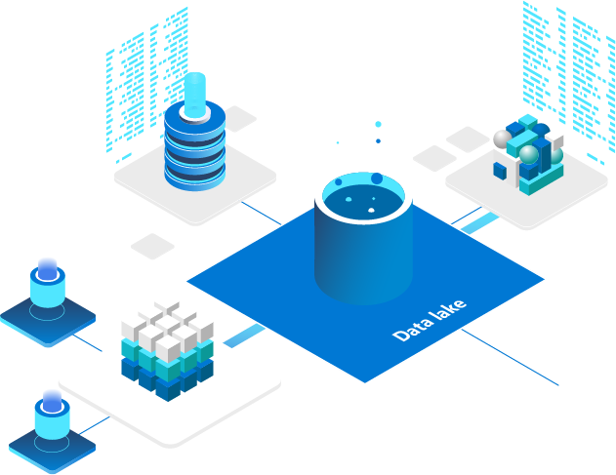
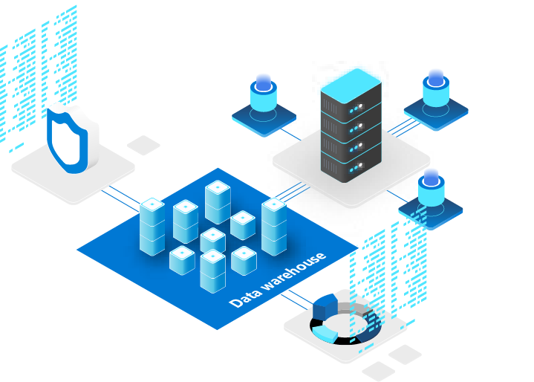
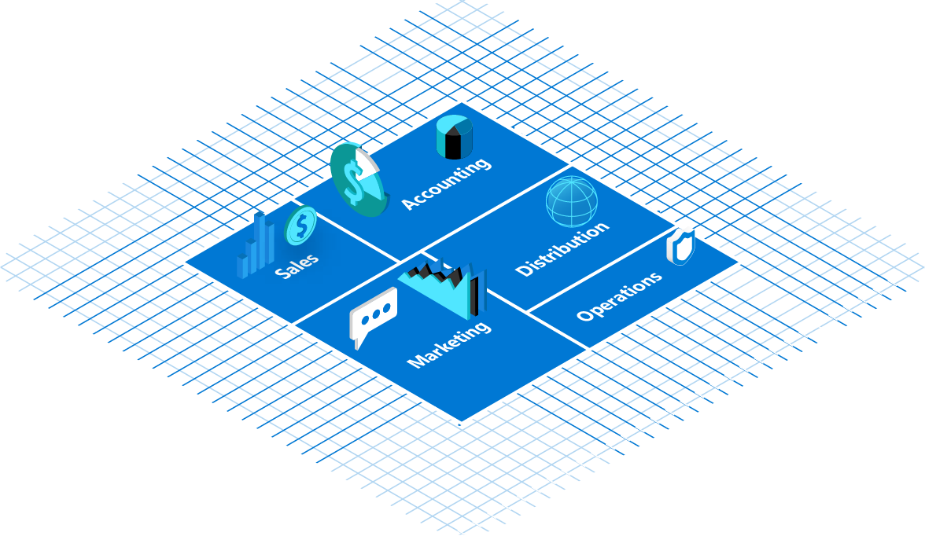
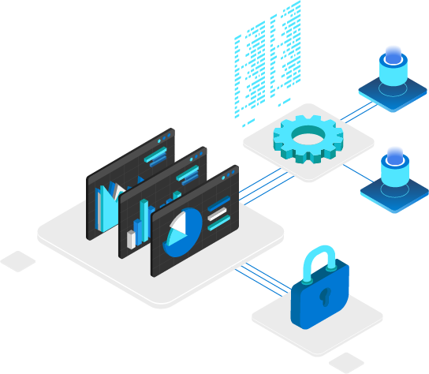


Agenda
Apache Spark - Overview of Apache Spark.
Apache Spark in Synapse - How Spark is utilized within Synapse.
Notebooks - Understand the notebook paradigm and how to use them in Synapse.
Machine Learning - How to train and deploy models with Synapse.

Slide 6
Apache Spark Overview

Slide 7


Question…
How have you seen Spark used in your customer engagements?
What use-cases does it excel in?

Slide 8
Apache Spark
A unified, open source, parallel, data processing framework for Big Data Analytics
Spark Unifies:
Batch Processing
Interactive SQL
Real-time processing
Machine Learning
Deep Learning
Graph Processing
Spark SQL
Batch processing
Spark ML/MLlib
Machine Learning
Spark Streaming
Stream processing
GraphX
Graph Computation
Spark Core Engine
Yarn
http://spark.apache.org
Notes:
Spark SQL
Unified data access: Query structured data sets with SQL or DataFrame APIs
Fast, familiar query language across all your enterprise data
Use BI tools to connect and query via JDBC or ODBC drivers
MLlib & SparkML
Predictive and prescriptive analytics
Machine learning algorithms for:
Clustering
Classification
Regression
etc.
Smart application design from pre-built, out-of-the-box statistical and algorithmic models
Spark Streaming
Micro-batch event processing for near-real time analytics
e.g. Internet of Things (IoT) devices, Twitter feeds, Kafka (event hub), etc.
Spark’s engine drives some action or outputs data in batches to various data stores
GraphX
Represent and analyze systems represented by graph nodes
Trace interconnections between graph nodes
Applicable to use cases in transportation, telecommunications, road networks, modeling personal relationships, social media, etc.

Slide 9



Motivation for Apache Spark
Traditional Approach: MapReduce jobs for complex jobs, interactive query, and online event-hub processing involves lots of (slow) disk I/O
HDFS Read
Iteration 1
HDFS Write
HDFS Read
Iteration 2
HDFS Write
CPU
Memory
CPU
Memory

Slide 10
Motivation for Apache Spark
Traditional Approach: MapReduce jobs for complex jobs, interactive query, and online event-hub processing involves lots of (slow) disk I/O
Solution: Keep data in-memory with a new distributed execution engine
HDFS Read
Iteration 1
HDFS Write
HDFS Read
Iteration 2
HDFS Write
CPU
Memory
CPU
Memory
HDFS Read
Iteration 1
Minimal Read/Write Disk Bottleneck
Iteration 2
Chain Job Output into New Job Input
CPU
Memory
CPU
Memory
Input
10–100x faster than network & disk

Slide 11


What makes Spark fast?
In-memory cluster computing: Spark provides primitives for in-memory cluster computing. A Spark job can load and cache data into memory and query it repeatedly (iteratively) much quicker than disk-based systems.
Scala Integration: Spark integrates into the Scala programming language, letting you manipulate distributed datasets like local collections. No need to structure everything as map and reduce operations
Faster Data-sharing: Data-sharing between operations is faster as data is in-memory:
In (traditional) Hadoop data is shared through HDFS which is expensive. HDFS maintains three replicas.
Spark stores data in-memory without any replication.
Data Sharing between Steps of a Job
Read from HDFS
Write to HDFS
Read from HDFS
Write to HDFS
In Traditional MapReduce
Step 1
Step 2
Read from HDFS
In Spark
Step 1
Step 2

Slide 12
General Spark Cluster Architecture
‘Driver’ runs the user’s ‘main’ function and executes the various parallel operations on the worker nodes.
The results of the operations are collected by the driver
The worker nodes read and write data from/to Data Sources including HDFS.
Worker node also cache transformed data in memory as RDDs (Resilient Distributed Datasets).
Worker nodes and the Driver Node execute as VMs in public clouds (AWS, Google and Azure).
Driver Program SparkContext
Cluster Manager
Node
Node
Node
Cache
Cache
Cache
Task
Task
Task
Data Sources (HDFS, SQL, NoSQL, …)

Slide 13
Apache Spark in Azure Synapse Analytics

Slide 14

Azure Synapse Apache Spark - Summary
Apache Spark 3.1 derivation
Linux Foundation Delta Lake 1.0 support
.Net Core 3.1 support
Python 3.8 + Anaconda support
Scala 2.12 support
Tightly coupled to other Azure Synapse services
Integrated security and sign on
Integrated Metadata
Integrated and simplified provisioning
Integrated UX including nteract based notebooks
Fast load of SQL Analytics pools
Core scenarios
Data Prep/Data Engineering/ETL
Machine Learning via Spark ML and Azure ML integration
Extensible through library management
Efficient resource utilization
Fast Start
Auto scale (up and down)
Auto pause
Min cluster size of 3 nodes
Multi Language Support
.Net (C#), PySpark, Scala, Spark SQL, Java

Slide 15
Synapse Job Service
AAD
Synapse Studio
Synapse Service
Gateway
Auth Service
Job Service Frontend
…
Resource Provider
Spark API Controller
DB
Job Service Backend
Azure
Instance Creation Service
Spark Plugin
…
DB
DB
Spark Instance
VM
VM
VM
VM
VM
VM
Notes:
User attaches Notebook to Spark pool and enters one or more Spark statements (code blocks).
The Notebook client gets user token from AAD and sends a Spark session create request to Synapse Gateway.
Synapse Gateway authenticates the request and validates authorizations on the Workspace and Spark pool and forwards it to the Spark (Livy) controller hosted in Synapse Job Service frontend.
The Job Service frontend forwards the request to Job Service backend that creates two jobs – one for creating the cluster and the other for creating the Spark session.
The Job service backend contacts Synapse Resource Provider to obtain Workspace and Spark pool details and delegates the cluster creation request to Synapse Instance Service.
Once the instance is created, the Job Service backend forwards the Spark session creation request to the Livy endpoint in the cluster.
Once the Spark session is created the Notebook client sends Spark statements to the Job Service frontend.
Job Service frontend obtains the actual Livy endpoint for the cluster created for the particular user from the backend and sends the statement directly to Livy for execution.

Slide 16
Spark Instance Creation
Azure Resource Provider
3
Provision Resources
Spark Instance
2
Create VMs with
Specialized VHD
Subnet
VM – 001
VM – 002
VM – 003
VM – 004
VM – 005
Spark Executors
Spark Executors
Spark Executors
Spark Executors
Hive Metastore
YARN NM - 01
Livy - 01
YARN NM - 02
Zookeeper - 01
Zookeeper - 02
Zookeeper - 03
YARN RM - 01
YARN RM - 02
YARN NM - 03
YARN NM - 04
Node Agent
Node Agent
Node Agent
Node Agent
Node Agent
1
Create Cluster
Synapse Cluster
Service
(Control Plane)
4
Heartbeats
Heartbeat sequence
Notes:
Synapse Job Service sends request to Cluster Service for creating clusters per the description in the associated Spark pool.
Cluster Service sends request to Azure using Azure SDK to create VMs (required plus additional) with specialized VHD.
The specialized VHD contains bits for all the services that are required by the Cluster type (for e.g. Spark) with prefetch instrumentation.
Once VM boots up, the Node Agent sends heartbeat to Cluster Service for getting node configuration.
The nodes are initialized and assigned roles based on their first heartbeat.
Extra nodes get deleted on first heartbeat.
After Cluster Service considers the cluster ready, it returns the Livy end-point to the Job Service.

Slide 17
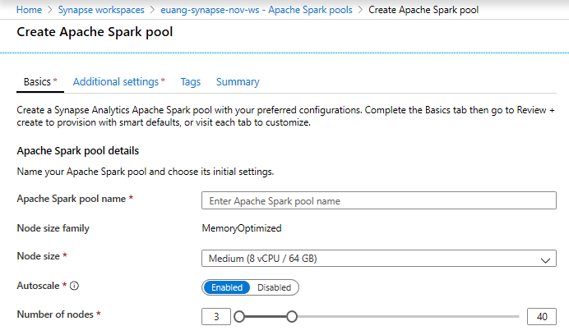
Creating a Spark pool (1 of 3)
Provision Spark Pool through Azure Portal with default settings or per requirements
Basic Settings – Minimum details required from user
Only required field from user
Default Settings

Slide 18
Creating a Spark pool (2 of 3)
Autoscaling - Dynamic Allocation of Executors (optional) - Allows a job to scale the number of executors within the min and max executor threshold
More efficiently allocates resources reflective of the job being run
When requirements are vastly different across stages of a spark job
The volume of data being processed fluctuates with time
Configuration via User Interface or code*
%%configure –f { “conf”: {
“spark.dynamicAllocation.maxExecutors”: 6,
“spark.dynamicAllocation.enable”: “true”,
“spark.dynamicAllocation.minExecutors”: “2” }
}
* The defaults specified through code will override the values set through the user interface

Slide 19
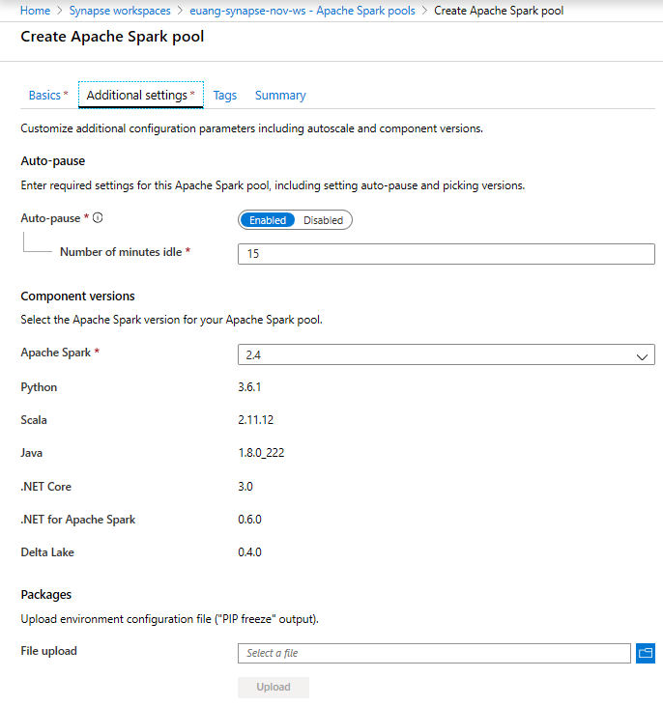
Creating a Spark pool (3 of 3) - optional
Additional Settings offer optional settings to customize Spark pool
Customize component versions, auto-pause
Import libraries by providing text file containing library name and version

Slide 20
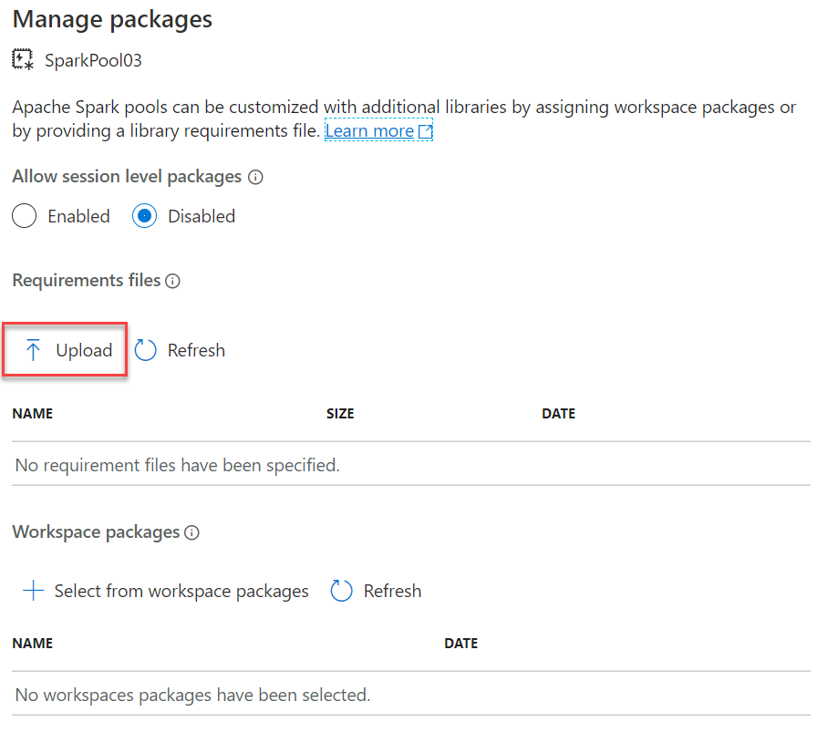
Library Management - Python
Overview
Customers can add new python libraries at Spark pool level
Benefits
Input requirements.txt in simple pip freeze format
Add new libraries to your cluster
Update versions of existing libraries on your cluster
Ability to specify different requirements file for different pools within the same workspace
Support for custom Wheel files when uploaded to the workspace default file system.
Constraints
The library version must exist on PyPI repository
Version downgrade of an existing library not allowed
Wheel files must be installed at a specific path:
abfss://<file_system>@<account_name>.dfs.core.windows.net/synapse/workspaces/<workspace_name>/sparkpools/<pool_name>/libraries/python/
Notes:
Manage libraries for Apache Spark - Azure Synapse Analytics | Microsoft Docs
Current default installed libraries and versions:
Apache Spark version support - Azure Synapse Analytics | Microsoft Docs

Slide 21
Python Library Requirements Format
Overview
The requirements text file has specific format requirements. These files are traditionally created in Python environments by running the pip freeze command but are also easy to create by hand.
File must be named requirements.txt.
Each line contains a requirement specifier.
This must contain at least the package name. You can also specify optional extras, an operator and version numbers according to the PIP requirements file standard.
The basic operators used by version specifiers are:
An exact version (using ==).
A minimum version (using > or >=).
A maximum version (using < or <=).
The extras listed in square brackets ([]) allow you to install additional components or variants of the library.
libraryname ==1.3.0

Slide 22
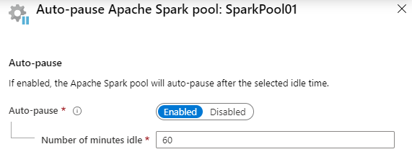
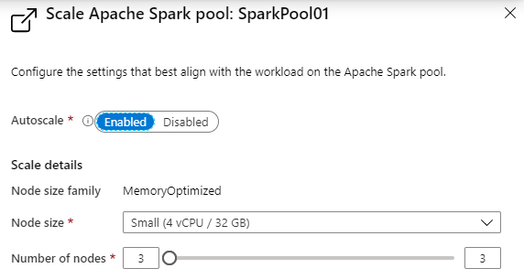
Spark Pools - Configuring
Auto-pause
Enables the pool to automatically stop running when no Spark applications (e.g., Notebooks) are running.
Autoscale
Enables the pool to automatically adjust the number of running nodes (VM’s) supporting the Spark pool.
Note: Just because a pool is running, does not mean all the nodes allowed to run, according to the scale configuration, are actually running. They will be allocated on demand as new Notebooks are executed, up to the limit configured in autoscale.

Slide 23
Optimizing Spark Performance

Slide 24
Use the right data abstraction
DataFrames
Best choice in most cases
Catalyst optimization
Whole-stage code generation
Direct memory access
Low GC overhead
Less dev friendly than DataSets
DataSets
Good in complex ETL pipelines
Considerable performance hit in aggregations
Catalyst optimization
Dev friendly
Serialization/deserializatioverhead
High GC overhead
Breaks whole-stage code generation
RDDs
Except for very special cases (new custom RDD), they are not needed
No Catalyst optimization
No whole-stage code generation
High GC overhead
Require Spark 1.x legacy APIs
Notes:
Optimize Spark jobs for performance - Azure Synapse Analytics | Microsoft Docs
Catalyst optimizer – query optimizer for Spark SQL (What is the Catalyst Optimizer? – Databricks)

Slide 25
Data formats, cache, and memory
Data formats
Standard formats (CSV, JSON, XML, PARQUET, ORC, AVRO)
Extensible via external data sources
Best format is PARQUET with SNAPPY compression
SNAPPY can be larger than GZIP but decompresses faster
Cache
Native mechanisms (.persist(), .cache(), CACHE TABLE)
Effective with small data sets and ETL pipelines to cache intermediate results
Native caching does not work well with partitioning
Memory
Prefer smaller partitions
With partitioning, keep in mind data size, types, and distribution
Consider Kryo data serialization instead of Java
Monitor and tune Spark configuration settings
Notes:
Optimize Spark jobs for performance - Azure Synapse Analytics | Microsoft Docs
Catalyst optimizer – query optimizer for Spark SQL (What is the Catalyst Optimizer? – Databricks)
Kryo serialization - https://github.com/EsotericSoftware/kryo

Slide 26
Other considerations
Optimize data serialization (Kryo vs. Java)
Use bucketing – works well for partitioning on large numbers of values (e.g., product ids)
Buckets are determined by hashing the bucket key of each row
Bucketed tables store metadata about how they are bucketed and sorted
Optimize joins and shuffles
Look for data skews
Check join types (SortMerge is default, but Broadcast might work better for smaller data sets or asymmetric joins)
Merge join is available for bucketed tables
The order of joins matters
Select the correct executor size
Optimize job execution
Cache as necessary
Broadcast variables to executors
Use the thread pool on the driver
Notes:
Optimize Spark jobs for performance - Azure Synapse Analytics | Microsoft Docs
Catalyst optimizer – query optimizer for Spark SQL (What is the Catalyst Optimizer? – Databricks)
Kryo serialization - https://github.com/EsotericSoftware/kryo

Slide 27
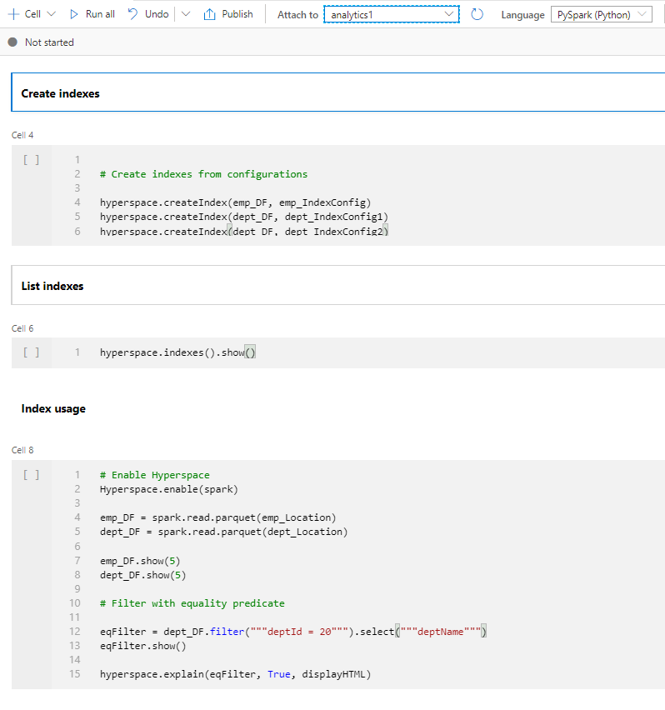
Hyperspace
Overview
Hyperspace introduces the ability for Apache Spark users to create indexes on their data
Benefits
It helps accelerate your workloads or queries containing filters on predicates with high selectivity or a join that requires heavy shuffles.
Maintain the indexes through a multi-user concurrency model.
Leverage these indexes automatically, within your Spark workloads, without any changes to your application code for query/workload acceleration.
It supports index operations as create index, list index, restore index, delete index, vacuum index
Languages supported: Scala, Python, .NET
Notes:
Hyperspace indexes for Apache Spark - Azure Synapse Analytics | Microsoft Docs

Slide 28
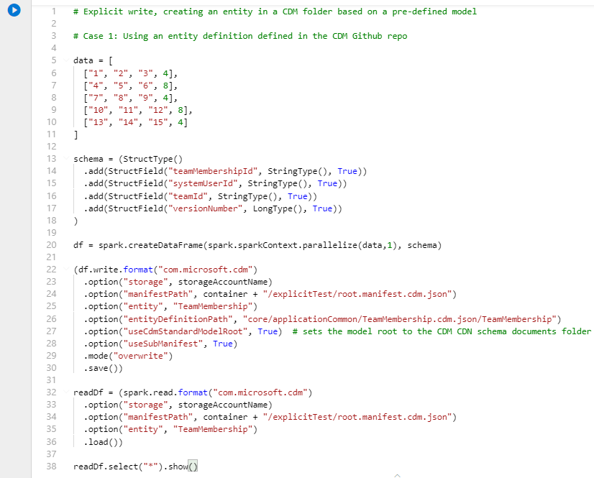
Spark CDM connector
Overview
It offers Spark dataframes to read and write entities in a CDM folder.
Benefits
It supports use of Managed Identities for Azure resources to mediate access to the Azure datalake storage.
Writes from a Spark dataframe to an entity in a CDM folder based on dataframe schema or CDM entity definition.
Supports data in Apache Parquet format and CSV format.
The CDM connector is pre-installed and supports languages: Python, Scala
Notes:
Azure/spark-cdm-connector (github.com)

Slide 29
Notebooks in Azure Synapse Analytics

Slide 30
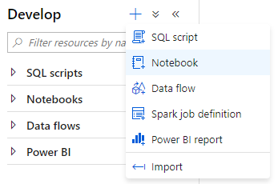
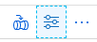
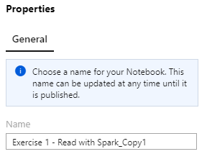
Creating a Notebook
Notebook creating
Create a new notebook within the Develop hub of Synapse Studio.
Notebook naming
The name of the Jupyter notebook can be set in the Properties dialog. You can now re-name published notebooks!

Slide 31
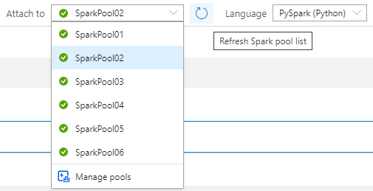
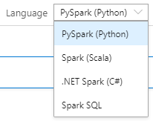
Notebook setup
Selecting the Spark pool to attach to
In the notebook toolbar, select the Spark pool to attach to before running any cells in the notebook.
Notebook default language
The default language used for all cells in the notebook is selected in the Language drop down.
You can override this for any particular cell to use a different language by using the appropriate cell magic (covered later).

Slide 32
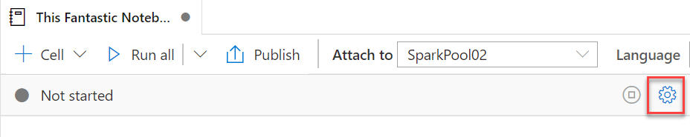
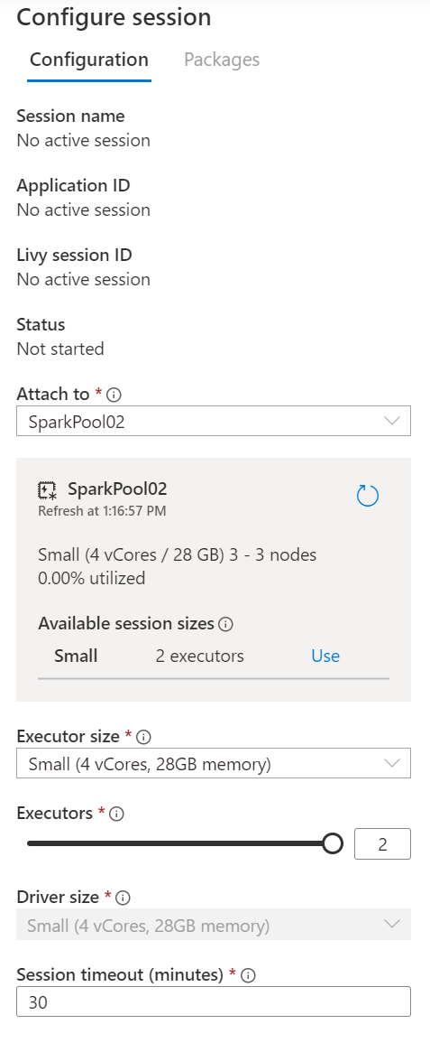
Notebook setup – Session configuration
A Spark session is created upon first run of any cell in a notebook. The configuration for a Spark session can only be set before it is created.
The Spark session allocates one Spark application.
This Spark application consumes a fixed set of resources, as defined in the session configuration. These resources are reserved from the total resources available in the Spark pool upon session start.
Each session reserves resources for at least one driver process and two executor processes. You can configure the size of executors, as well as the number of executors. The size of the driver is always the same as the executors.
A session ends when the notebook is closed or when the session timeout is reached without any activity in the notebook. You can configure the session timeout.

Slide 33
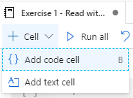
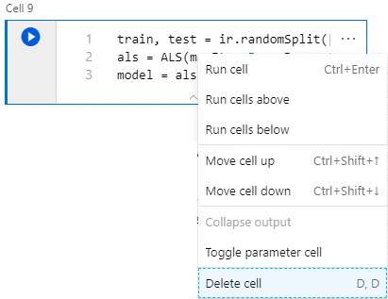
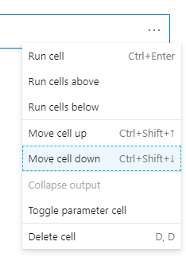
Notebook capabilities – Cell management
Add code or text cells
Remove code or text cells
Adjust cell order

Slide 34
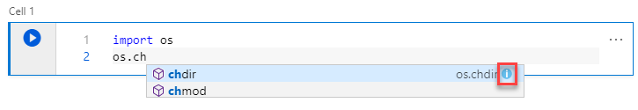
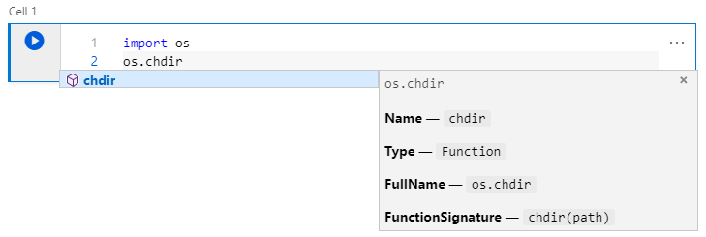
Notebook capabilities – Editing code
Statement completion
Use Ctrl + Space to display
Inline documentation
Select the information tooltip to display

Slide 35
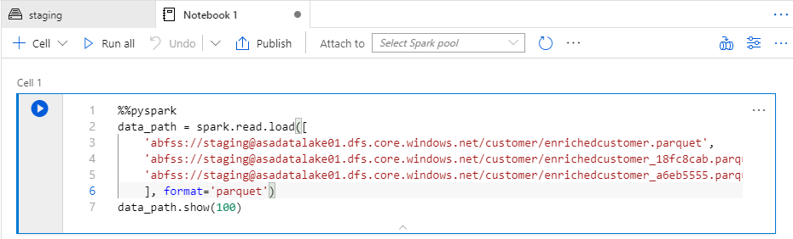
Notebook capabilities – Editing code
Cell magics
Use cell magics to change the language used when interpreting the cell.
These must be the first line in the cell.
Magic | Description
%%pyspark | Execute Python code against Spark Context.
%%spark | Execute Scala code against Spark Context.
%%sql | Execute Spark SQL query against Spark Context.
%%csharp | Execute Spark.NET C# code against Spark Context.

Slide 36
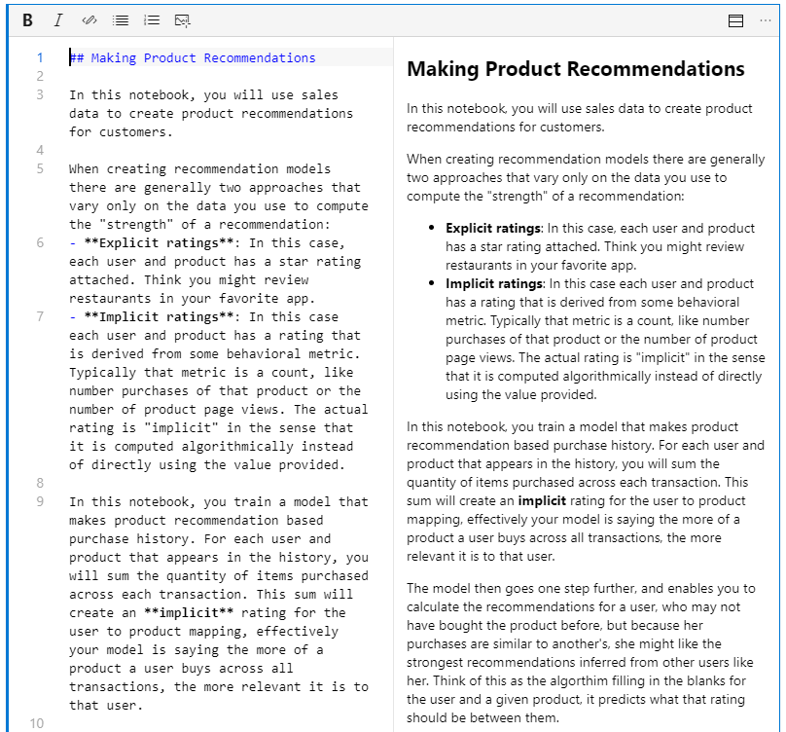
Notebook capabilities – Editing text cells
Support for GitHub flavored markdown
Notebooks support GitHub flavored markdown, enabling limited text formatting, links, lists, code blocks and images.

Slide 37
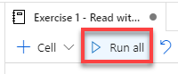
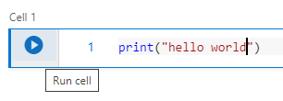
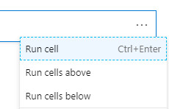
Notebook capabilities – Running cells
Run all cells from toolbar
Run current cell from toolbar from cell itself

Slide 38
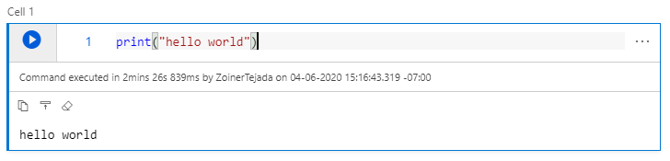
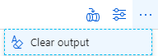
Notebook capabilities – Cell output
Cell output
Clear all cells output from toolbar

Slide 39
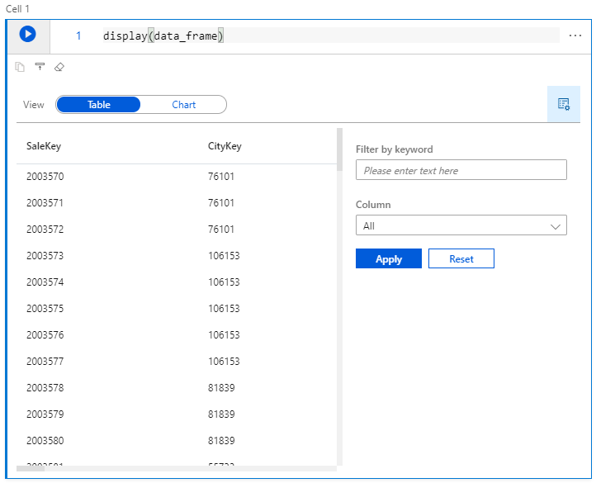
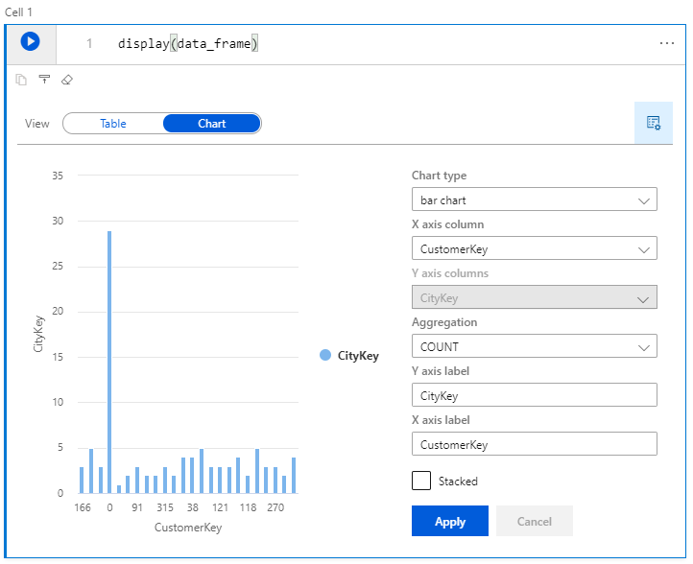
Spark Pools – Notebook capabilities
View DataFrame content as table or chart
Use the display function and pass in your dataframe.

Slide 40
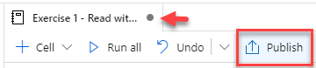
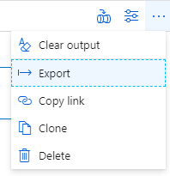

Spark Pools – Notebook capabilities
Saving (publishing)
Exporting (download the .ipynb)

Slide 41
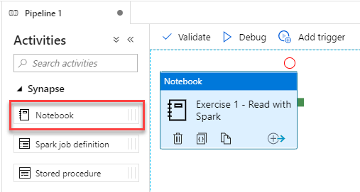
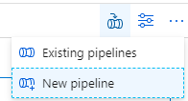
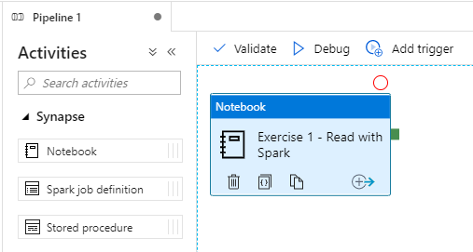
Notebook capabilities – Use in pipelines
Notebooks are pipeline activities
Execute a notebook as a step in a new pipeline

Slide 42
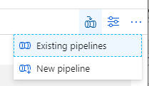
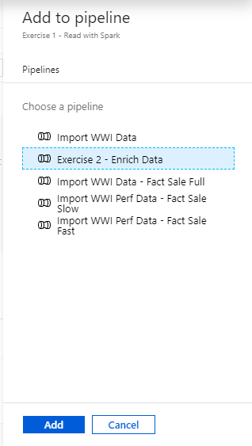
Notebook capabilities – Use in pipelines (2)
Execute a notebook as a step in an existing pipeline

Slide 43
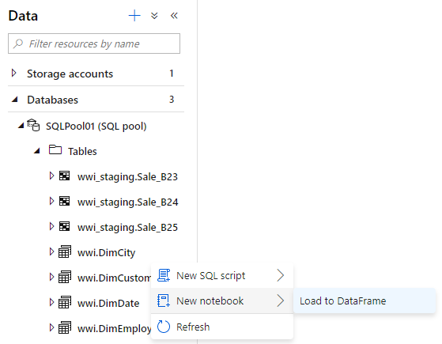
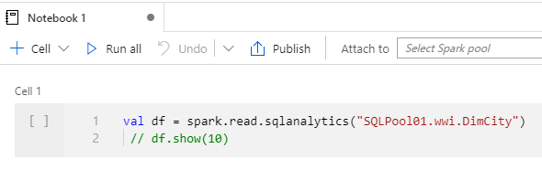
Notebook capabilities – Querying SQL Pools
Loading a SQL Pool table to a DataFrame

Slide 44
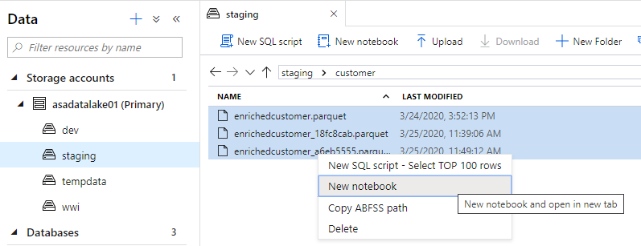
Notebook capabilities – Querying Parquet Files
Loading Parquet files to a DataFrame

Slide 45
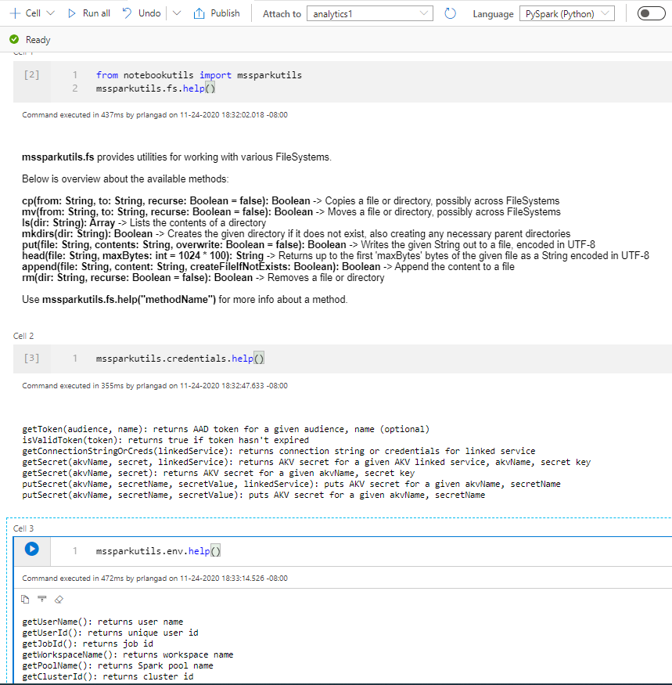
Microsoft Spark Utilities
Overview
It provides utilities for working with file systems, including ADLS Gen2 and Azure Blob Storage.
Benefits
It supports multiple methods for file systems such as List, Copy, Move, Write, Append, Delete file or directory, View file properties, Create new directory, Preview file content.
It supports environment utilities to get username, user id, job id, workspace name, pool name, cluster id.
It supports to get the access tokens of linked services and manage secrets in Azure Key Vault.
Notes:
Microsoft Spark Utilities

Slide 46
Pop Quiz #4
What types of library sources are supported in Apache Spark in Azure Synapse Analytics?
Maven
Spark
PyPi

Slide 47
Pop Quiz #4
What types of library sources are supported in Apache Spark in Azure Synapse Analytics?
Maven
Spark
PyPi

Slide 48

The Spark Side
Are you ready ?

Slide 49
Machine Learning in Azure Synapse Analytics

Slide 50

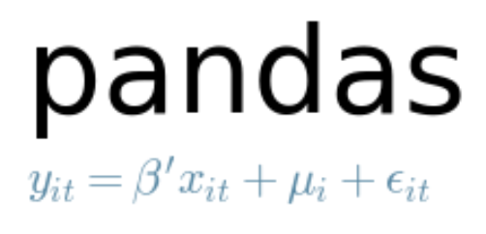











Examples of tools for data science used in Notebooks
Core frameworks and tools
Machine Learning & Deep Learning
Keras
PyTorch
Visualization

Slide 51
Spark ML Algorithms
Classification and Regression | Linear Models (SVMs, logistic regression, linear regression) Naïve Bayes Decision Trees Ensembles of trees (Random Forest, Gradient-Boosted Trees) Isotonic regression
Clustering | k-means and streaming k-means Gaussian mixture Power iteration clustering (PIC) Latent Dirichlet allocation (LDA)
Collaborative Filtering | Alternating least squares (ALS)
Dimensionality Reduction | SVD PCA
Frequent Pattern Mining | FP-growth Association rules
Basic Statistics | Summary statistics Correlations Stratified sampling Hypothesis testing Random data generation
Spark ML Algorithms

Slide 52


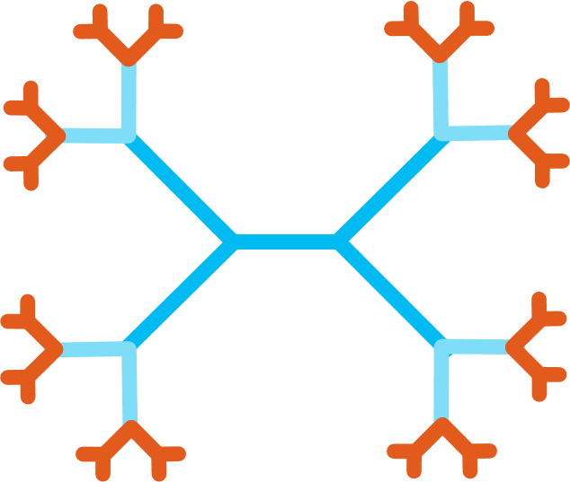




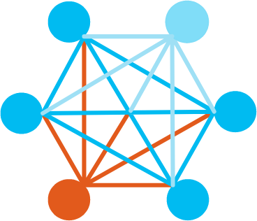

Cognitive Services on Spark
Stress Free Serving
Lightning Fast Gradient Boosting
SynapseML
Fast & Sparse Text Analytics
Distributed Microservices
Large Scale Model Interpretability
Scalable Deep Learning
Broad Language Support

Slide 53








Synapse Analytics and the Machine Learning Process
Prepare data
Train model
Use model
Azure Machine Learning
Azure Synapse SQL
Azure Synapse Analytics
Notebook
SQL Script
Spark Notebook
Train model
T-SQL PREDICT
Prepare data
SQL Script
Azure Databricks
(Spark-based Machine Learning)
Azure Kubernetes Service
Prepare data
Notebook
Web service
Train model
Real-time scoring

Slide 54

Making predictions with T-SQL
Create the model
Register the model
Use the model
Azure Machine Learning
Azure Synapse SQL
Azure Synapse SQL
Notebook
SQL Script
SQL Script
Train Model
Read model
Load from Table
Convert to ONNX
Load into Table
Use Predict
Export to Storage
Insert Predictions
Storage
Models
Notes:
The diagram illustrates the approach the Azure Synapse Analytics enables for machine learning.
Train the machine learning models using notebooks run within Azure Machine Learning. Use the machine learning framework of choice to do so. Model training should always be performed in AML.
Within this notebook, convert the model into the ONNX format and then upload the model to Azure Storage.
From there, run a T-SQL script in Azure Synapse SQL to load the model into a table in the database.
After this, use the model within T-SQL scripts running Azure Synapse SQL by loading the model from the table, and using it with the Predict statement to score data sourced from a table in the database. The scored results could then be used directly or be inserted into a target table for later querying of the predictions.

Slide 55
Predict
Overview
It provides ability to import existing machine learning models and score them within provisioned SQL. It takes ONNX (Open Neural Network Exchange) and data as inputs and generates prediction based on model.
Benefits
It empowers data engineers to successfully deploy machine learning models with the familiar T-SQL interface
It offers seamless collaboration with data scientists
It generates new columns, but the number of columns and their data types depends on the type of model that was used for prediction.
Syntax:
PREDICT
(
MODEL = @model | model_literal,
DATA = object AS <table_alias>
)
WITH ( <result_set_definition> )
<result_set_definition> ::=
{
{ column_name
data_type
}
[,...n ]
}
MODEL = @model | model_literal
Example:
DECLARE @model varbinary(max) = (SELECT Model FROM Models WHERE Id = <>);
SELECT d.*, p.Score
FROM PREDICT(MODEL = @model,
DATA = dbo.mytable AS d) WITH (Score float) AS p;

Slide 56
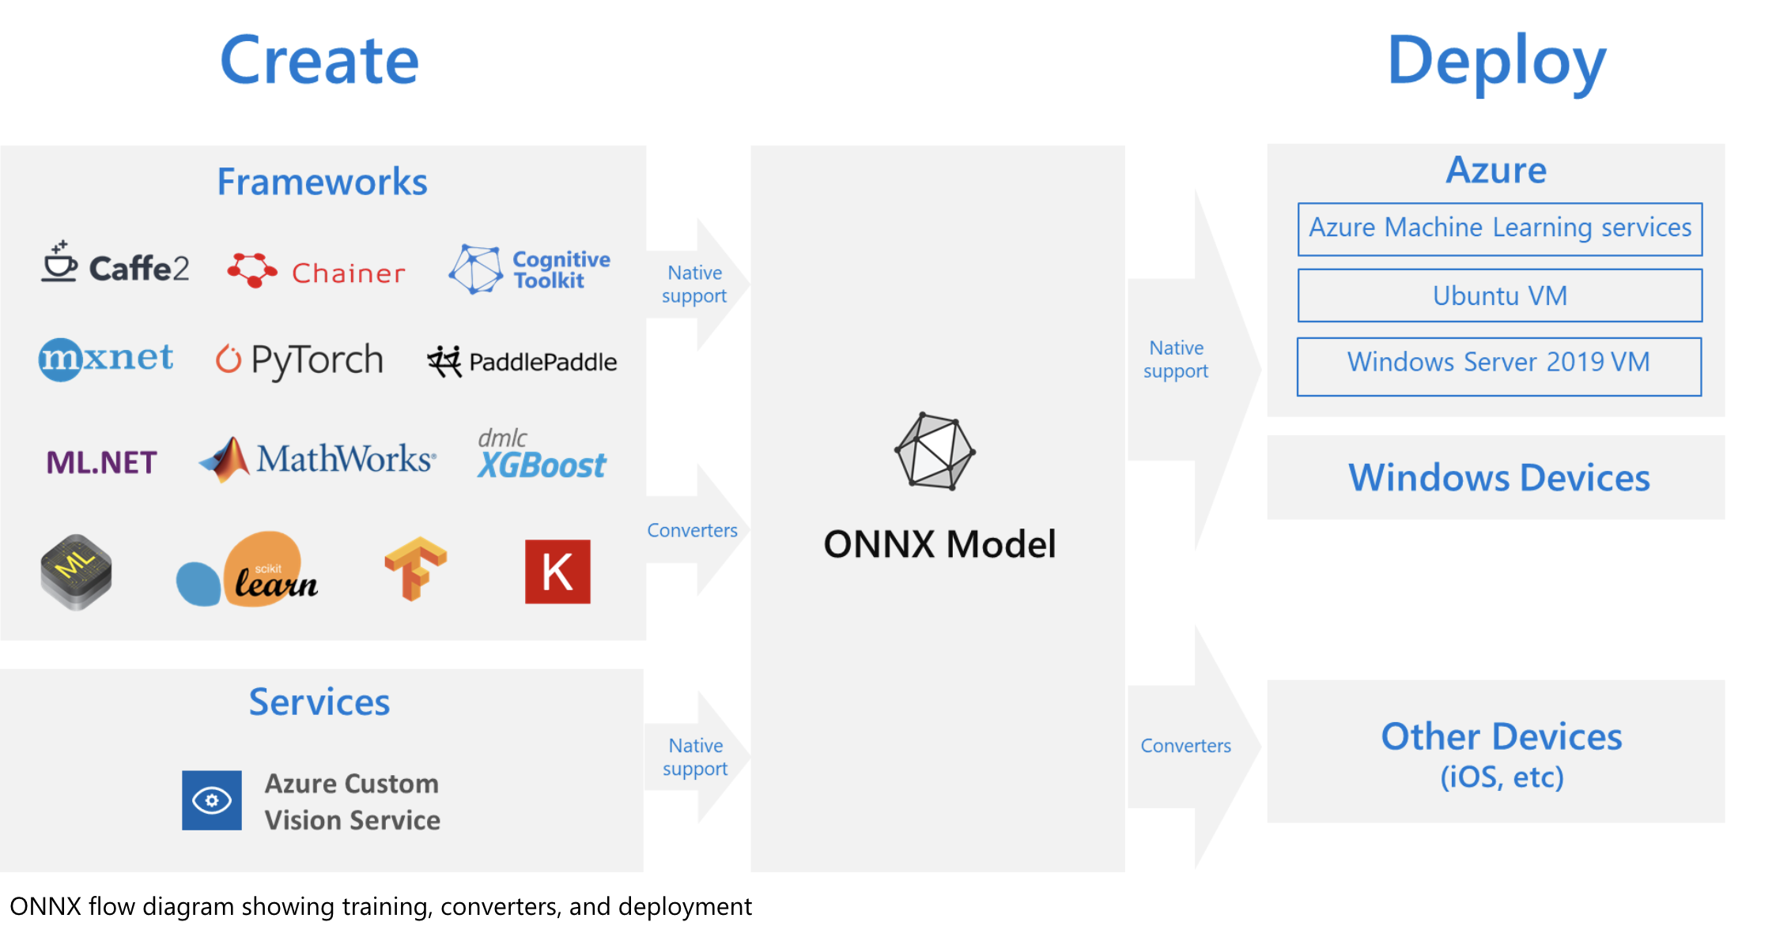
What is ONNX?
Notes:
The challenges of optimizing the performance of machine learning models in production is extremely hard considering the range of hardware capabilities on different platforms such as cloud vs edge, CPU vs GPU etc. and couple that with the variety of frameworks that available for building and training the machine learning models.
To support the idea of providing users the flexibility to train their machine learning models on framework of their choice, and run that model anywhere with optimal performance, is at the core of Open Neural Network Exchange (ONNX) format for representing machine learning models. ONNX is an open format, that is supported by a community of partners, including Microsoft, who create compatible frameworks and tools.
You can create ONNX models from many frameworks, including PyTorch, Chainer, Microsoft Cognitive Toolkit (CNTK), MXNet, ML.Net, TensorFlow, Keras, SciKit-Learn, and more. ONNX Runtime is optimized for both cloud and edge and works on Linux, Windows, and Mac, and it also integrates with accelerators on different hardware such as TensorRT on NVidia GPUs. ONNX models can be deployed to the cloud using Azure Machine Learning and ONNX Runtime. They can also be deployed to Windows 10 devices using Windows ML. They can even be deployed to other platforms using converters that are available from the ONNX community.
The interoperability you get with ONNX makes it possible to get great ideas into production faster. With ONNX, data scientists can choose their preferred framework for the job. Similarly, developers can spend less time getting models ready for production, and deploy across the cloud and edge.
Data scientists: use the framework of their choice to create and train models
Developers: deploy models cross-platform with minimal integration work

Slide 57
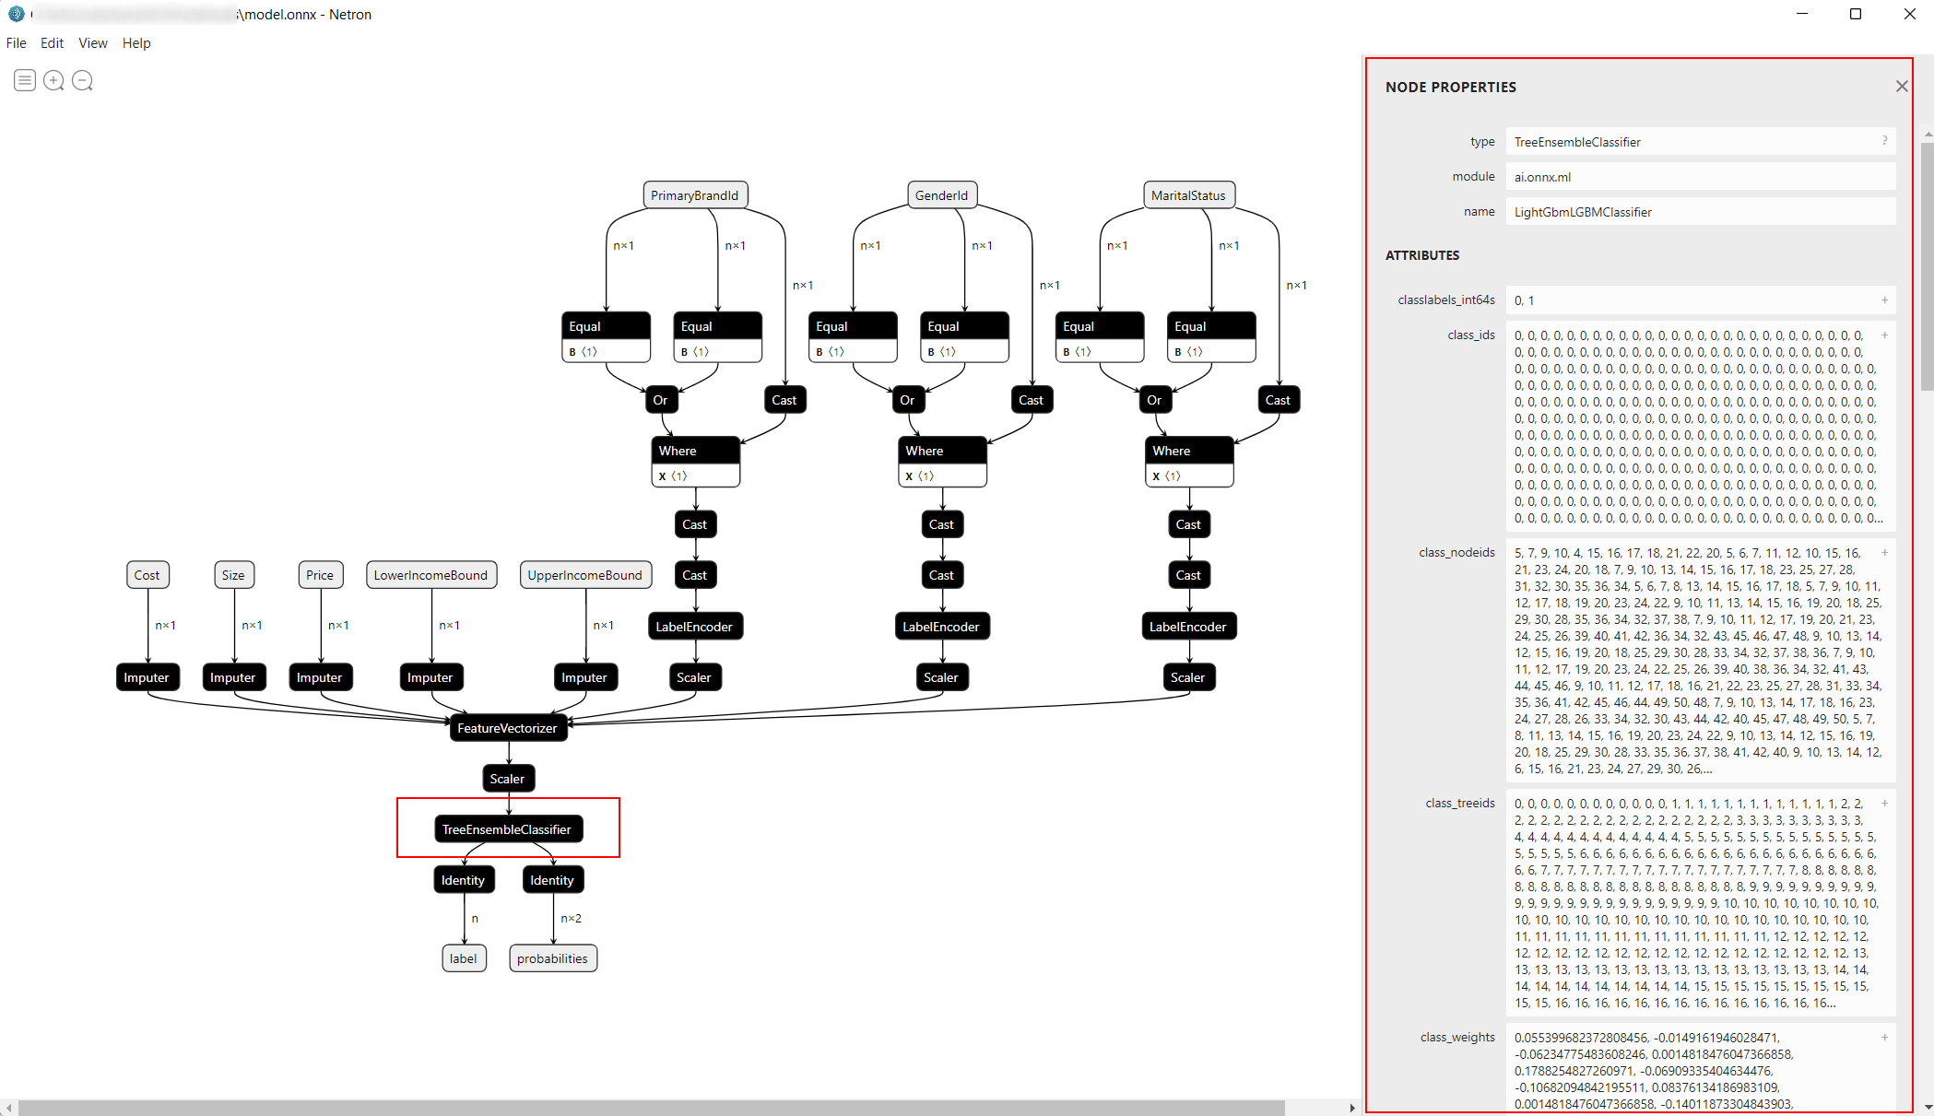
What is ONNX?
Notes:
Here is a great representation of an ONNX model rendered with the Netron viewer. Notice how ONNX represents all categories of components of an ML pipeline (inputs, encoders, scalers, imputers, feature vectorizers, ML models, and outputs).
https://netron.app/

Slide 58
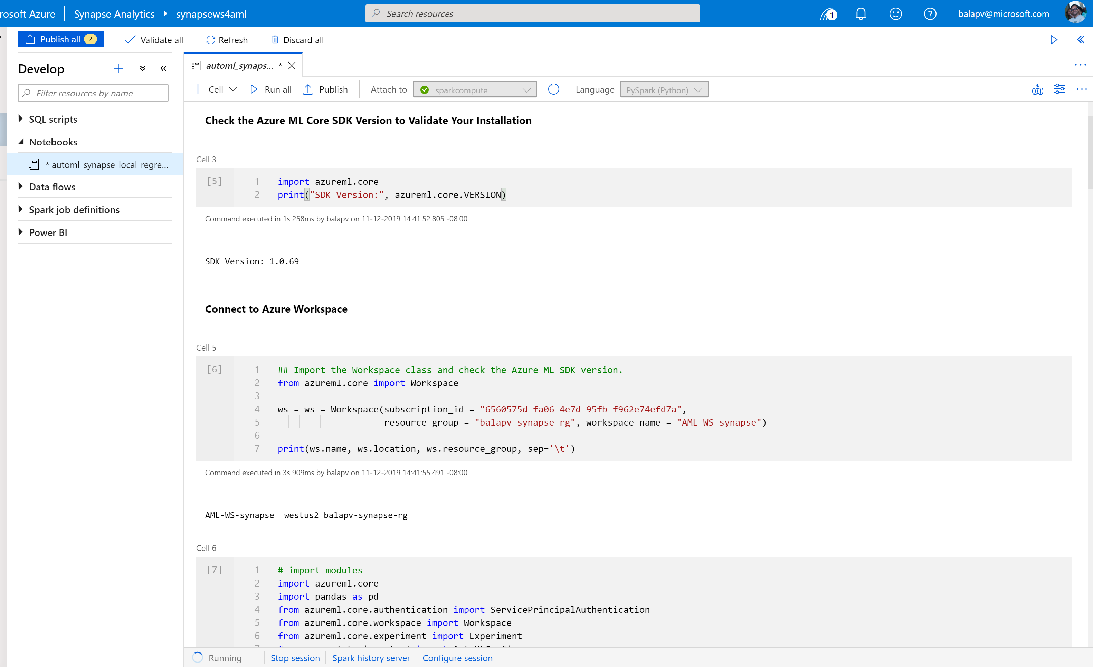
Synapse Notebook: Connect to AML workspace
Simple code to connect workspace

Slide 59
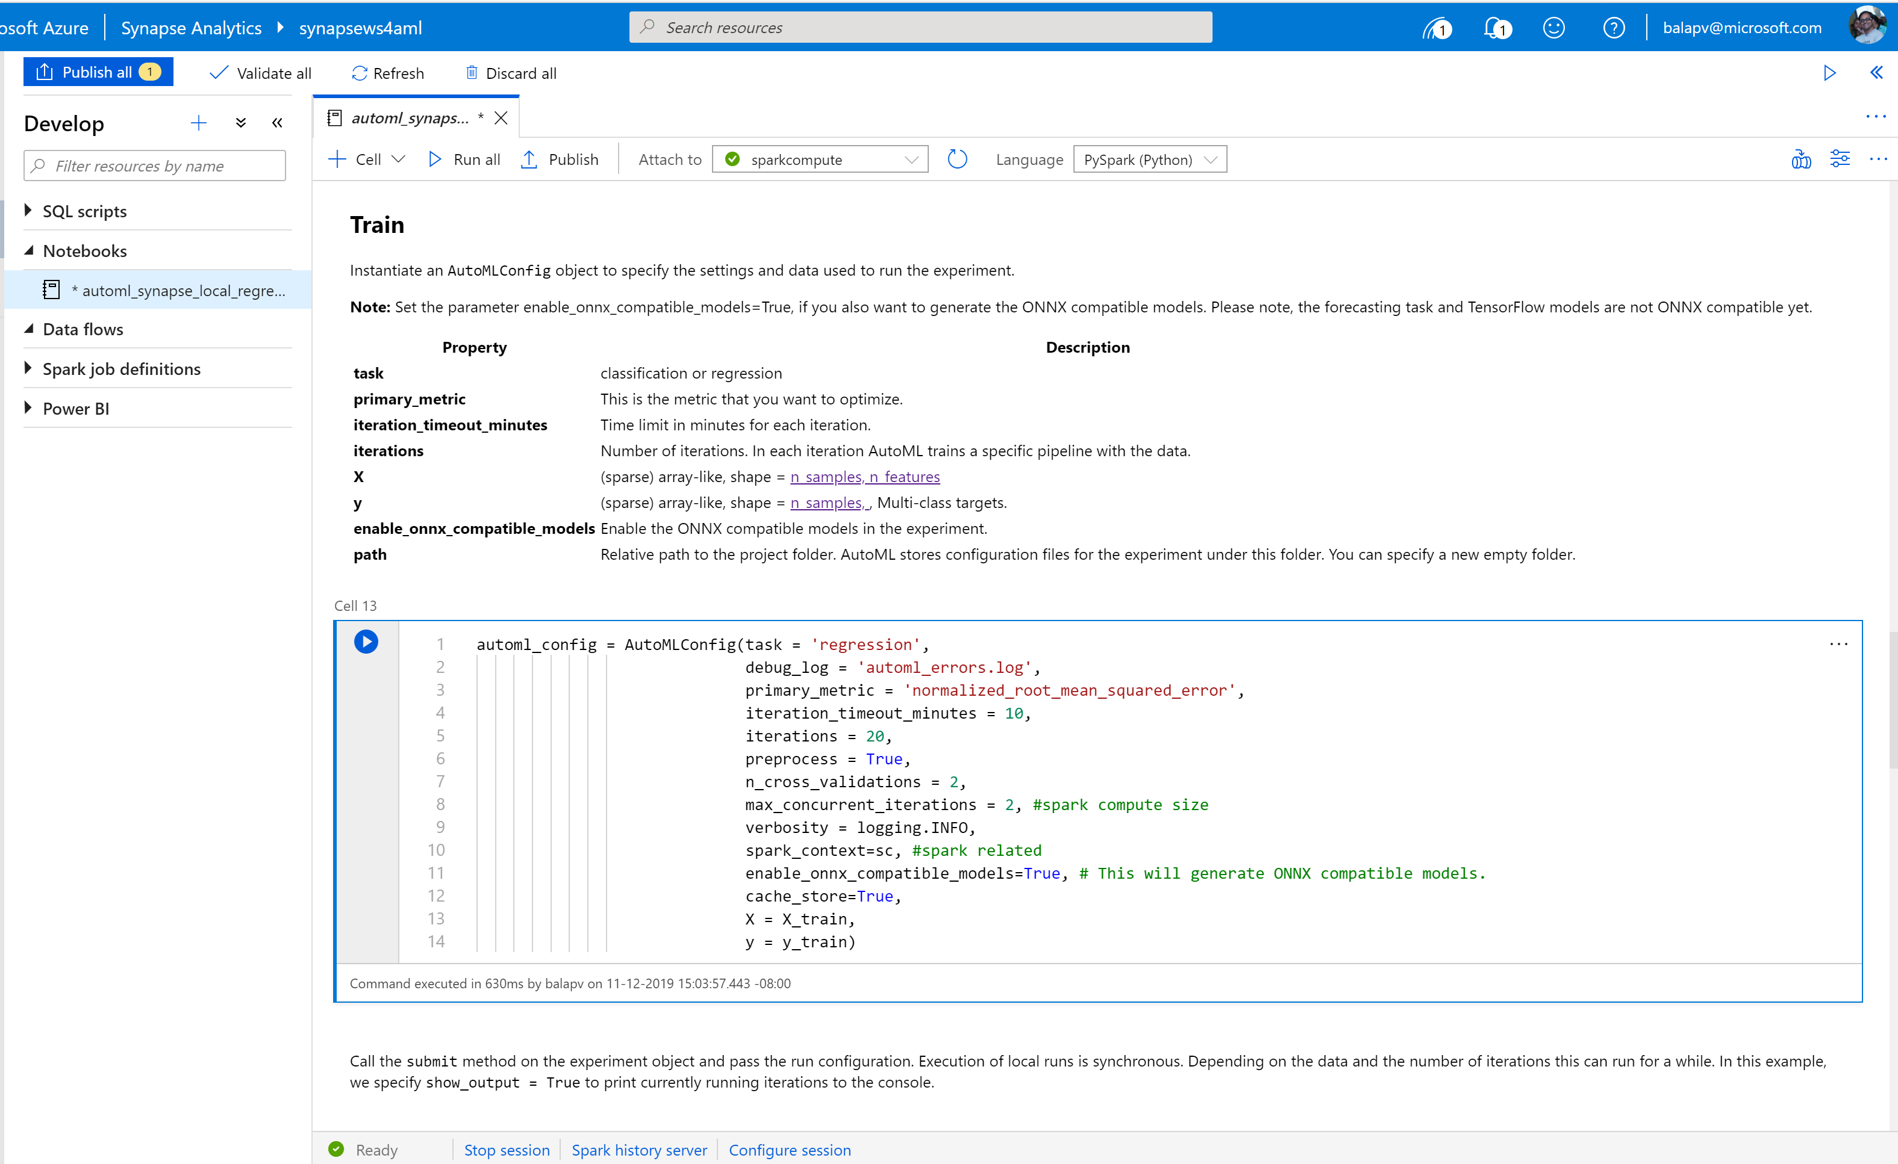
Synapse Notebook: Configure AML job to run on Synapse
Configuration parameters

Slide 60

Synapse Notebook: Run AML job
ML job execution result

Slide 61



Synapse AML Integration – Training a new model

Slide 62




Synapse AML Integration – Enriching data with an existing model

Slide 63










Azure Synapse Analytics
Modern Data Warehouse
Unified Experience
Azure Synapse Studio
On-prem
Integration
Database Templates
Management
Monitoring
Security
DevOps
Cloud data
Analytic runtimes
SQL
Data Explorer
Applications
Semantic Layer – Common Data Model
Streaming data
Data Warehouse
Data Lake
Event Brokers
Azure Synapse Link
Cosmos DB
Dataverse
Notes:
Azure Synapse unifies your data, your data tasks, and your data teams with a limitless analytics service that does it all. This is the result of a multi-year effort.
We set out to rearchitect and create the next generation of query processing and data management with Synapse to meet the needs of the modern, high scale, volume, velocity, and variety of data workloads.
As these modern workloads require both SQL and Apache Spark, we saw that customers would need a cloud-native analytics service engine that converged big data and data warehousing so they could achieve limitless scale on structured, semi-structured, and un-structured data.

Slide 64
Thank You

Slide 65
Monitor & Manage

Slide 66
Agenda
Monitoring - Monitor resources within Synapse Studio and the Azure Portal.
Manage - Manage resources for optimal utilization and performance.

Slide 67
Discussion…
How has the role of a DBA changed in the era of managed Data- Warehouses-as-a-Service?

Slide 68

Monitor Hub
Overview
This feature provides single pane of glass to monitor orchestration, activities for Apache Spark Application and SQL requests.
Benefits
Offers additional filters to monitor specific activities or orchestration

Slide 69


Monitor Hub - Integration
Overview
Monitor orchestration in the Synapse workspace for the progress and status of pipeline
Benefits
Track all/specific pipelines
Monitor pipeline run and activity run details
Find the root cause of pipeline failure or activity failure

Slide 70

Monitor Hub - Spark applications
Overview
Monitor Spark pools, Spark applications for the status of activities
Benefits
Apply filter for pool to get Apache Spark Applications per pool
Additional available filters include:
Application Name
Livy ID
Status
End time

Slide 71


Monitor Hub – SQL requests
Overview
Monitor SQL requests for the progress and status of activities
Benefits
Apply filter for pool to get SQL requests per compute pool
Validate query text
Additional available filters include:
Start time
End time
Request ID
Session ID
Submitter
Workload group

Slide 72


Monitor Hub – Analytics pools

Slide 73

Monitor SQL Pools
Overview
Monitor SQL Pool in Azure Portal for overall usage and query activities.
Benefits
Access SQL Audit Logs for my SQL computes
Monitor status and progress of all/specific activities
Dashboard view to monitor performance
Get to know scale of SQL compute resource

Slide 74
Manage

Slide 75
Workload Management
Pillars of Workload Management
Overview
It manages resources, ensures highly efficient resource utilization, and maximizes return on investment (ROI).
Synapse is moving away from Resource Class and Concurrency Slots to Workload Management.
The three pillars of workload management are
Workload Classification – To assign a request to a workload group and setting importance levels.
Workload Importance – To influence the order in which a request gets access to resources.
Workload Isolation – To reserve resources for a workload group.
Classification
Importance
Isolation

Slide 76
Workload classification
Overview
Map queries to allocations of resources via pre-determined rules.
Use with workload importance to effectively share resources across different workload types.
If a query request is not matched to a classifier, it is assigned to the default workload group.
Benefits
Map queries to both Resource Management and Workload Isolation concepts.
Monitoring DMVs
sys.workload_management_workload_classifiers sys.workload_management_workload_classifier_details
Query DMVs to view details about all active workload classifiers.
CREATE WORKLOAD CLASSIFIER classifier_name
WITH
(
WORKLOAD_GROUP = 'name’
, MEMBERNAME = ‘security_account'
[ [ , ] IMPORTANCE = {LOW|BELOW_NORMAL|NORMAL|ABOVE_NORMAL|HIGH} ] )
[ [ , ] WLM_LABEL = 'label' ]
[ [ , ] WLM_CONTEXT = 'name' ]
[ [ , ] START_TIME = 'start_time' ]
[ [ , ] END_TIME = 'end_time' ]
)[ ; ]
WORKLOAD_GROUP: maps to an existing resource class
IMPORTANCE: specifies relative importance of request
MEMBERNAME: database user, role, AAD login or AAD group

Slide 77


Workload importance
Overview
Queries past the concurrency limit enter a FiFo queue
By default, queries are released from the queue on a first-in, first-out basis as resources become available
Workload importance allows higher priority queries to receive resources immediately regardless of queue
Example Video
State analysts have normal importance.
National analyst is assigned high importance.
State analyst queries execute in order of arrival
When the national analyst’s query arrives, it jumps to the top of the queue
Azure Synapse
Analytics
CREATE WORKLOAD CLASSIFIER National_Analyst
WITH
(
WORKLOAD_GROUP = ‘analyst’
,IMPORTANCE = HIGH
,MEMBERNAME = ‘National_Analyst_Login’)
Notes:
Video example:
National Analyst is given a higher workload importance value

Slide 78
Workload Isolation
Overview
Allocate fixed resources to workload group.
Assign maximum and minimum usage for varying resources under load. These adjustments can be done live without having to take SQL Analytics offline.
Benefits
Reserve resources for a group of requests
Limit the amount of resources a group of requests can consume
Shared resources accessed based on importance level
Set Query timeout value. Get DBAs out of the business of killing runaway queries
Monitoring DMVs
sys.workload_management_workload_groups
Query to view configured workload group.
CREATE WORKLOAD GROUP group_name
WITH
(
MIN_PERCENTAGE_RESOURCE = value
, CAP_PERCENTAGE_RESOURCE = value
, REQUEST_MIN_RESOURCE_GRANT_PERCENT = value
[ [ , ] REQUEST_MAX_RESOURCE_GRANT_PERCENT = value ]
[ [ , ] IMPORTANCE = {LOW | BELOW_NORMAL | NORMAL | ABOVE_NORMAL | HIGH} ]
[ [ , ] QUERY_EXECUTION_TIMEOUT_SEC = value ]
)[ ; ]
Notes:
https://docs.microsoft.com/en-us/azure/sql-data-warehouse/sql-data-warehouse-workload-isolation

Slide 79
Discussion…
What are some of the advantages and disadvantages of workload isolation versus SQL Pool scaling?
Notes:
Scale can increase overall capacity, but empties the cache which slows performance.
Workload isolation can be more responsive to quick changes in workload.

Slide 80


Azure Advisor recommendations
Suboptimal Table Distribution
Reduce data movement by replicating tables
Data Skew
Choose new hash-distribution key
Slowest distribution limits performance
Cache Misses
Provision additional capacity
Tempdb Contention
Scale or update user resource class
Suboptimal Plan Selection
Create or update table statistics

Slide 81

Maintenance windows
Overview
Choose a time window for your upgrades.
Select a primary and secondary window within a seven-day period.
Windows can be from 3 to 8 hours.
24-hour advance notification for maintenance events.
Benefits
Ensure upgrades happen on your schedule.
Predictable planning for long-running jobs.
Stay informed of start and end of maintenance.

Slide 82
Manage Summary
Resource contention can be mitigated by applying Workload Management in Azure Synapse Analytics.
Workload Classification: Assign a request to a workload group and set importance levels.
Workload Importance: Influence the order in which a request gets access to resources.
Workload Isolation: Reserve resources for a workload group.
Use Azure Advisor recommendations to identify suboptimal table distribution, data skew, cache misses, tempdb contention, and suboptimal plan selection.
Avoid disruptive system downtime due to system upgrades by configuring maintenance windows and notifications in Azure Synapse Analytics.
Notes:
Exploratory queries that were not time sensitive can saturate the available resources and delay the execution of higher priority queries supporting critical reports, how can one mitigate this?
Separate marketing workloads from say the finance workloads using workload management.
Configure Workload Management in Azure Synapse Analytics which serves to prevent this situation.
It manages resources, ensures highly efficient resource utilization, and maximizes return on investment (ROI).
The three pillars of Workload Management are:
Workload Classification – To assign a request to a workload group and set importance levels.
Workload Importance – To influence the order in which a request gets access to resources.
Workload Isolation – To reserve resources for a workload group.
If workload management does not suffice, note that online scaling (which allows you to increase the cluster size without incurring downtime) and multi-cluster (which allows you to have several different clusters supporting a single data warehouse) are features that are coming soon.
How can you identify issues such as suboptimal table distribution, data skew, cache misses, tempdb contention and suboptimal plan selection?
Leverage the Azure Advisor recommendations.
There is a balance between the data warehouse software staying up to date and when a customer can afford downtime that might result. How can they establish their preferences, so they are never caught off guard with an upgrade?
Leverage maintenance windows, a feature of Azure Synapse Analytics. Within this they can:
Choose a time window for upgrades.
Select a primary and secondary window within a seven-day period, where windows can be from 3 to 8 hours.
Receive 24-hour advance notification for maintenance events.

Slide 83

Monitoring Activity Mentimeter Poll
Scan QR Code
or Go to www.menti.com and use code
7894 1936
Notes:
https://www.menti.com/tyb5a5vtow

Slide 84

Overall Training Mentimeter Poll
Scan QR Code
or Go to www.menti.com and use code
4743 6920
Notes:
https://www.menti.com/9bwqmqfitd

Slide 85
Thank You

